Slide 1
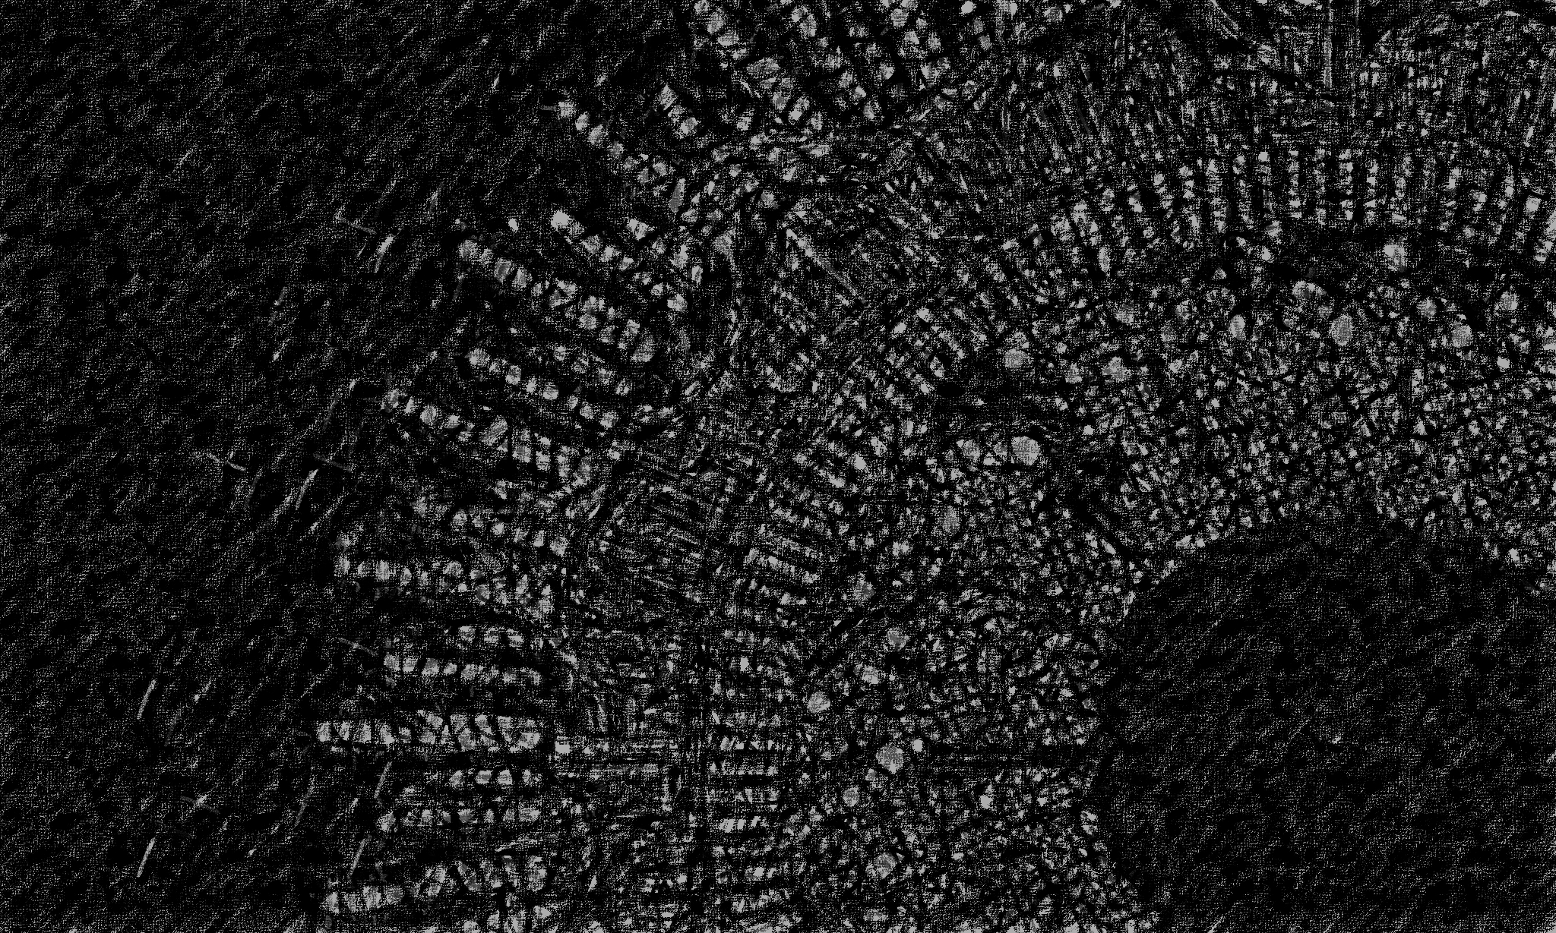


AI Workshop 4: Ethics of AI Tuesday 18th February 2025
Omar Choudhry

Slide 2

Learning Objectives
By the end of this lesson, you will learn:
What is a neural network?
What are weights and bias’?
What is an activation function?
What is forward propagation?
What is backward propagation?
What is gradient descent?
How can you build a simple neural network?

Slide 3
Simulating the Brain?
Human brain generates about 23 watts of power (enough to power a lightbulb)
Power source is renewable energy from food
Power efficiency is orders of magnitude higher than electronic computers
Can perform an exaflop (a billion-billion mathematical operations per second)
Most powerful computer performs 1.7 exaflops
But it uses 24.6 megawatts (246 000 000 watts)
Each human brain is 10 billion times more efficient

Slide 4
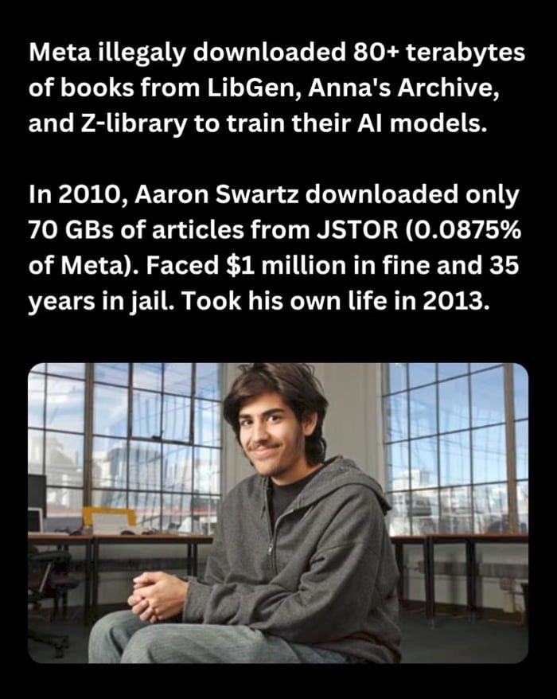

Slide 5


Contact
Contact
Slides are available at github.com/omariosc/ai-workshops
WhatsApp Community Chat
O.Choudhry@leeds.ac.uk

